Slide 1
Longitudinal Motion
Eric Prebys, UC Davis

Slide 2
Acceleration in Periodic Structures
We consider motion of particles either through a linear structure or in a circular ring
Always negative
In both cases, we can adjust the RF phases such that a particle of nominal energy arrives at the the same point in the cycle φ_{σ}
Goes from negative to positive at transition

Slide 3
Slip Factors and Phase Stability
The sign of the slip factor determines the stable region on the RF curve.
η<0 (linacs and below transition)
η>0 (above transition)
“bunch”
Particles with lower E arrive earlier and see greater V.
Particles with lower E arrive later and see greater V.
Nominal Energy
Nominal Energy

Slide 4
Longitudinal Acceleration
Consider a particle circulating around a ring, which passes through a resonant accelerating structure each turn
The energy gain that a particle of the nominal energy experiences each turn is given by
where this phase will be the same for a particle on each turn
A particle with a different energy will have a different phase, which will evolve each turn as
Harmonic number (number of RF cycles per period)
Period of nominal energy particle
Synchronous phase
Phase difference from one turn to the next

Slide 5
Phase Difference
The phase difference can be expressed as
“synchronous” (nominal) energy

Slide 6
Longitudinal Equation of Motion
Thus the change in energy for this particle for this particle will evolve as
So we can write
Constant (or very slowly varying)
exact

Slide 7
Synchrotron Motion and Synchrotron Tune
Rewrite this equation as:
For small oscillations,
And we have
This is the equation of a harmonic oscillator with
Angular frequency wrt turn (not time)
“synchrotron tune” = number of oscillations per turn (usually <<1)

Slide 8
Longitudinal Phase Space and Emittance
We want to write things in terms of time and energy. We have can write the longitudinal equations of motion as
Following our procedure for longitudinal motion, we want to write this in form:

Slide 9
Taking the derivative wrt n and substituting for ΔE gives us
So we can write
But we’ve seen that before!

Slide 10
This looks just like our equation for transverse motion with α=0, so we immediately write
Where
Units: s/eV
Units: eV/s

Slide 11
We can define an invariant of the motion as
What about the behavior of Δt and ΔE separately?
Note that for linacs or well-below transition
Area=πε_{L}
units generally eV-s
Aspect ratio

Slide 12
Large Amplitude Motion
We have solved for the synchrotron tune in the limit of small oscillations, but in general we will not restrict ourselves to small oscillations.
Recall our exact equations of motion:
Multiply both sides by and integrate over dn
substitute
constant
extrema
exact

Slide 13
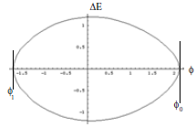
Orbits
The relationship between phase angle and ΔE is given by

Slide 14
Stable Region
The range in φ will be determined by the classical turning points
One end point of the maximum stable orbit is defined by the right maximum
The other end is defined by

Slide 15
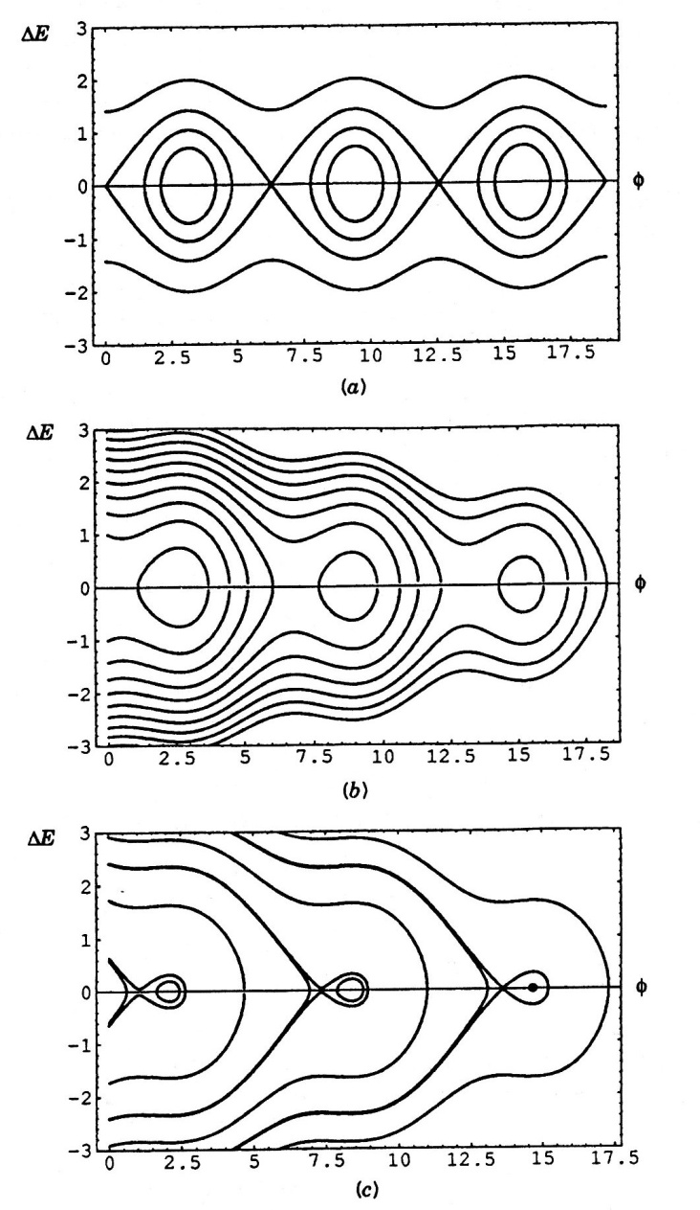
Separatrix
The “separatrix”, or maximum stable orbit, is defined by

Slide 16
Longitudinal Bucket
The “bucket” is the area contained within the separatrix
The “bucket height” is the maximum ΔE, which will occur when φ=φ_{s}.

Slide 17
Transition Crossing
We learned that for a simple FODO lattice so electron machines are always above transition.
Proton machines are often designed to accelerate through transition.
As we go through transition
Recall so these both go to zero at transition.
To keep motion stable
At transition:

Slide 18
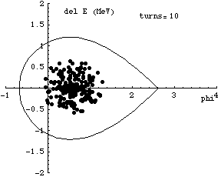
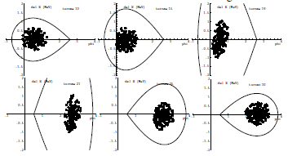

Effects at Transition
As the beam goes through transition, the stable phase must change*
Problems at transition (pretty thorough treatment in S&E 2.2.3)
Beam loss at high dispersion points
Emittance growth due to non-linear effects
Increased sensitivity to instablities
Complicated RF manipulations near transition
Much harder before digital electronics
*animations from Gerry Dugan

Slide 19
RF Manipulations
As you’ll show in homework, the synchrotron tune (longitudinal oscillations/turn) is generally <<1.
That means that if there are multiple RF cavities around the ring, the orbiting particle will see the vector sum of the cavities.
We will clearly get the maximum energy gain if all phases are the same, so (assuming all voltages are the same)
RF1
RF2
RF3
RF3
φ_{i} is the phase angle at the arrival of the particle at cavity i

Slide 20
Do we always want the maximum acceleration?
As we’ll see, there are times when we want to change the amplitude of the RF quickly.
Because cavities represent stored energy, changing their amplitude quickly can be difficult.
Much quicker to change phase
Standard technique is to divide RF cavities into two groups and adjust the relative phase. In the simplest case, we put half the RF cavities into group “A” and half into group “B”. We can adjust the phases of these cavities relative to our nominal synchronous phase as
So
Like “turning RF off”

Slide 21

Adiabatic Capture*
We initially capture the beam by raising the RF voltage “adiabatically” (over many synchrotron oscillations). This insures that the longitudinal phase space stays matched to the RF bucket
If instead we simply turn the RF on, the beam will “filament”.
dp/p
z [m]
z [m]
dp/p
z [m]
z [m]
(*Synergia simulations: IOTA ring, protons, K=2.5 MeV, τ=1.77 μsec, h=4, V_{max}=1kV)

Slide 22
Capture and Acceleration
We can adiabatically capture beam by increasing the RF voltage with no accelerating phase
As we accelerate beam, Δt decreases. Recall
So as beam accelerates, bunches get narrower

Slide 23
Bucket to Bucket Transfer
In general, the accelerating gradient of an RF structure is
So when bunches get short enough, it’s advantageous to transfer to a higher frequency. For example, in the Fermilab Linac
200 MHz Linac
800 MHz Linac
Transfer beam to every 4th bucket

Slide 24
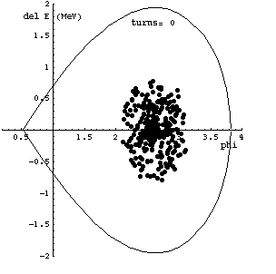
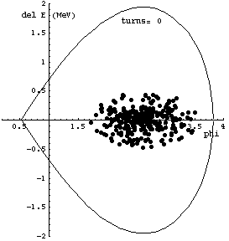
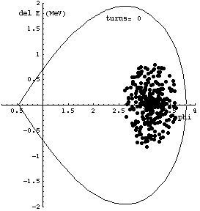



Bucket Transfers: Phase and Beta Matching
When we transfer beam from one machine to another, or from a lower frequency section to a higher frequency section, it’s important to correctly match the phases!
Matched transfer
β_{L} mismatch
Phase mismatch

Slide 25
Bunch Rotation
If we slowly change the RF voltage (or effective voltage by phasing), we can adiabatically change the bunch shape
If we suddenly change the voltage, then the bunch will be mismatched and will rotate in longitudinal phase space

Slide 26
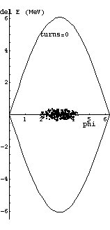

Bunch Rotation (cont’d)
Of course, non-adiabatically increasing the RF voltage (“snapping”) will cause the beam to filament, but the effect is minor over ¼ of a synchrotron oscillation

Slide 27
RF “Gymnastics”
By manipulating the RF in the system, very sophisticated things can be done*
Example: Bunch splitting:
*R. Garoby, “RF Gymnastics in Synchrotrons”

Slide 28
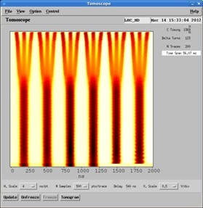
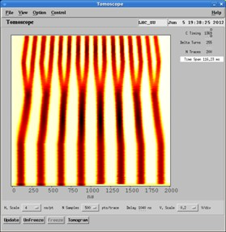
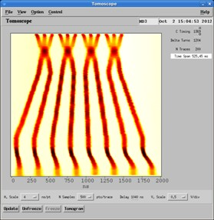
Example: Bunch formation in CERN PS for LHC*
turn
time
*S. Hancock

